Slide 1

MMDE 11-150 Web Design
Lecture 10
→Multimedia Team Development and Web Hosting
Semester 102
Dr. James Birt

Slide 2
Outline
Development Stages
Development Team
Cycles
Process
Hosting

Slide 3
Development Stages

Slide 4
Key stages of development
Concept
Analysis
Design
Production
Maintenance

Slide 5
Concept
Scope and clarify the project brief
Form a development team
Plan

Slide 6
Project Scope
What does the client want
Clarify the requirements
Ask lots and lots and lots of questions
Who is their target market?
What do they want out of the project?
Will they provide images / sound etc or will you have to create them?
Will it need to be interactive?
When does it need to be done by?
How many pages, how long, etc.
Etc.
A lot of the time they do not know what they want!

Slide 7
Magic triangle
They can only choose two
Good
Fast
Cheap

Slide 8

Website Development
Large scale projects are not usually completed by one or two individuals.
They are created by a group of people working as a TEAM

Slide 9
Website Development
Large scale projects:
Project Manager
Information Architect
Marketing Representative
Copywriter
Editor
Graphic Designer
Data Base Administrator
Network Administrator
Web Developer
Smaller Scale projects mean Web developers would double up on roles e.g. one person may also be:
the Project Manager,
Graphic Designer,
Database admin and or
Information architect
Notes:
A substantial site could require writers, information architects, graphic designers, technical experts and an overseeing producer.
People create and people decide the success of the project.
Many organizations do not develop their own web sites; instead they hire an outside web development company (potential for professional careers in this area)

Slide 10
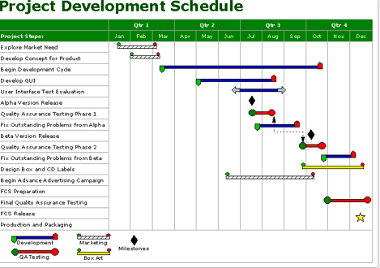
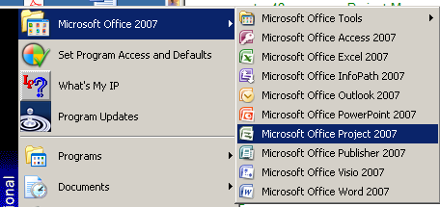
Project Manager
The Project Manager oversees the Website development process and coordinates the team activities.
They create the project plan/s and schedule
They are accountable for project milestones and results.
(GANTT Chart)
Must have excellent organisational, managerial and communication skills.

Slide 11
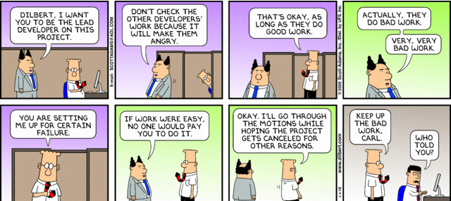
Plan the work, then work the plan
The oldest joke in business is:
“Good, fast, or cheap? Pick any two.”
If you are developing anything more than a small web site, make sure you have an experienced web project manager.

Slide 12
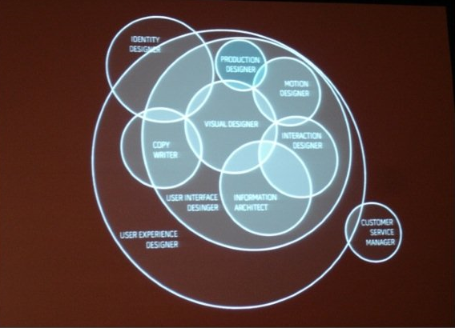
Information Architect
Information Architect: clarifies mission and goals and assists in determining functionality of website.
This role is often taken on by the Web Developer or Project Manager.
http://www.klariti.com/information-architecture/role-Information-Architecture.shtml
Notes:
Assign tasks to team members. The Information Architect often doubles up as the Project Manager. Capture the site’s design goals. Communicate the business objectives, such as the site’s sales targets, audience, and language requirements. Create access points to content from different in-coming pages. Design the navigation system, menus, sitemaps etc. Label and organize data. Map content to the appropriate section. Protect users from getting lost on the site.

Slide 13

Website Development Group
Marketing works with Web Designers to create a Web presence
The Copywriter must work with Editor , essentially inline with the Content Manager to ensure correct grammar and consistency
Content Manager everything - must be able to facilitate change

Slide 14
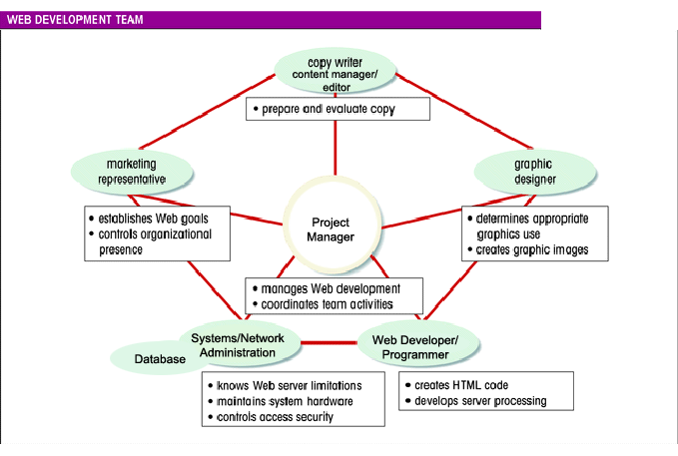

Slide 15
The Development Process
Identify Opportunity
Evaluation
Review Site
Analysis
Gather Requirements
Delivery
Maintenance
Fix and Enhance Site
Design
Define the Solution
Production
Create content,
construct site
Launch
Testing
Notes:
Analysis: Define: Goals and Target Market - Content and Asset collection - Content and style information Delivery requirements
Design:- Comps - screen shots - Design Review - Redesign - Production Storyboard
Production: SITE PRODUCTION- TECHNICAL TEST and bug list -
Delivery - Test Usability -
Personalize Revision - Test revision -
Delivery - Final presentation - final revision
Launch (promotion)
Online

Slide 16
Analysis
Documentation should determine:
Information topics, hierarchy – used as a starting point for navigation.
Functionality requirements: e.g. accept credit cards, process orders etc.
Environmental requirements: hardware, operating system, screen resolution, what bandwidth will visitors most likely use? Web Server requirements.
Determine Content requirements.
Review competitor sites
Estimate costs
Do a cost/ benefit analysis

Slide 17
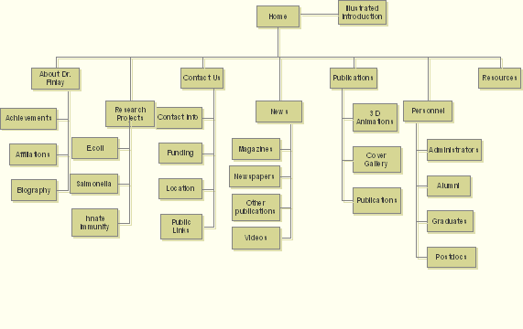
Design
Once everyone knows what is needed determine how it can be accomplished:
Choose a site map organisation (linear , random etc)

Slide 18
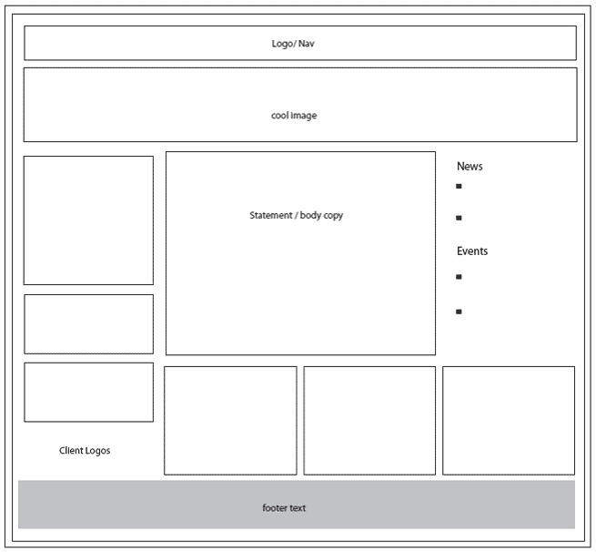
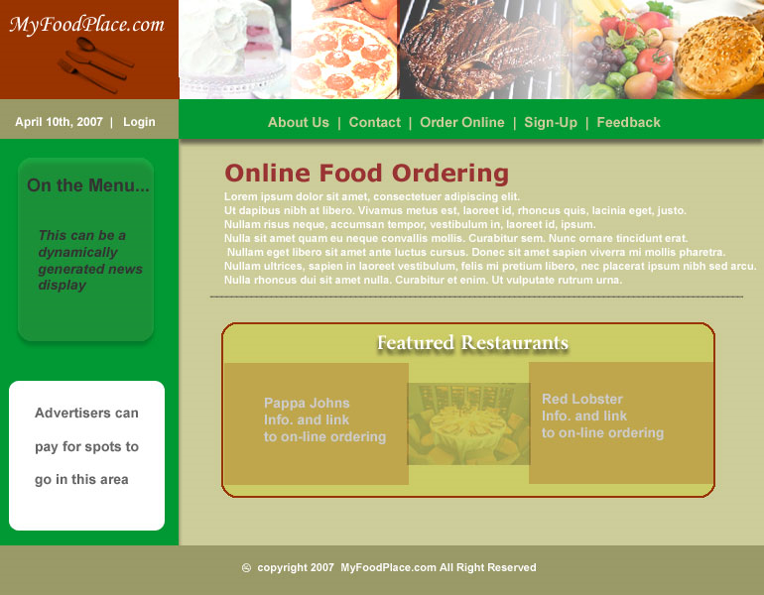
Design
Create a Page layout Design
Prototype the design, - it can even be usability tested at this stage with a focus group.
Document each page
Get client approval…

Slide 19
Production
All previous work should come together for a useable and effective Website!
The Web developers must keep to schedule now – they may need to consult with other project members as needed for clarification and approval – A Very critical time.
Any standards should be determined at this time
Site file organisation/ naming conventions
Graphic designers and Web developers work to create and individually test units.(Unit testing)

Slide 20

Testing
Different browsers and browser versions.
Different screen resolutions
Different bandwidths
Test from a different location
No such thing as too much testing – create a test plan!

Slide 21
Quality Assurance and Non Function Requirements
Performance
How quickly must the system respond to interactive operations of different kinds?
What are the expected performance bottlenecks?
Scalability
Peak load of how many users doing what kinds of operations?
Hardware Scaling – What can be scaled and impact on load

Slide 22
Quality Assurance and Non Function Requirements
Availability
What is the required uptime percentage?
Rules of 9
Reliability
What is the expected mean time to failure by failure severity by operation?
How will reliability be assessed prior to deployment?
Security
What operations need to be secured?
How will users be administered?
How will users be given permissions to access secured operations?
What are the different levels of security and how do these map

Slide 23
Quality Assurance and Non Function Requirements
Maintainability
Are there concerns about the ability to hire appropriate technology skills
What sort of maintenance documentation and plans are expected to be produced?
What sort of regression testing is required to ensure that maintenance changes do not degrade existing functionality?
Flexibility/Testability
Is there system behavior that needs to be changed regularly without program changes?
How easy are these changes?

Slide 24
Quality Assurance and Non Function Requirements
Usability (Covered in previous weeks)
Portability
Data portability between this system and other systems?
Browser portability? What browser versions? Historical and future?
Conformance to standards
What legal standards apply?
What technical standards apply?
What development standards apply?

Slide 25

Maintenance and Evaluation
A Website is never finished!
Once all approvals are in, the Website is Launched. It is crucial to test/check once all live
Marketing & Promotion activities usually occur now.
Evaluate original goals – does your Website meets them?
If not consider how to enhance the site through Development again

Slide 26
Hosting

Slide 27
What is Web Hosting?
A web hosting service is a type of Internet hosting service that allows individuals and organizations to make their own website accessible via the World Wide Web.
Web hosts are companies that provide space on a server they own or lease for use by their clients as well as providing Internet connectivity.

Slide 28

Hosting Needs
Small to Medium Website:
Look for unlimited data transfer- 60 mb or more of hard disk space, email, and support of server side scripting such as ASP and PHP.
Known as Virtual Hosting
Choose a host that will meet future possible needs too – as your site changes.

Slide 29
Hosting Needs
Large to Enterprise Website:
Consider large National Web hosting that will support Chat Rooms and streaming media content.
High bandwidth , OC-1 or higher- 24 hr staffing – Check service and response time
Also consider a dedicated Web server
Notes:
OC-1 is a SONET line with transmission speeds of up to 51.84 Mbit/s optical fiber
Dedicated Web server exclusive use of a computer and connection to the internet that is housed on the Web hosting company premises

Slide 30
Hosting
Why do I care which operating system my Web host provider uses?
It helps with troubleshooting your site
A site may be fine on a local laptop but falls apart later after being published on a free Web server that uses a different operating system.
For example: Windows treat upper and lowercase letters in the same way;
UNIX and Linux are case sensitive -which can result in broken links
Notes:
Why do

Slide 31
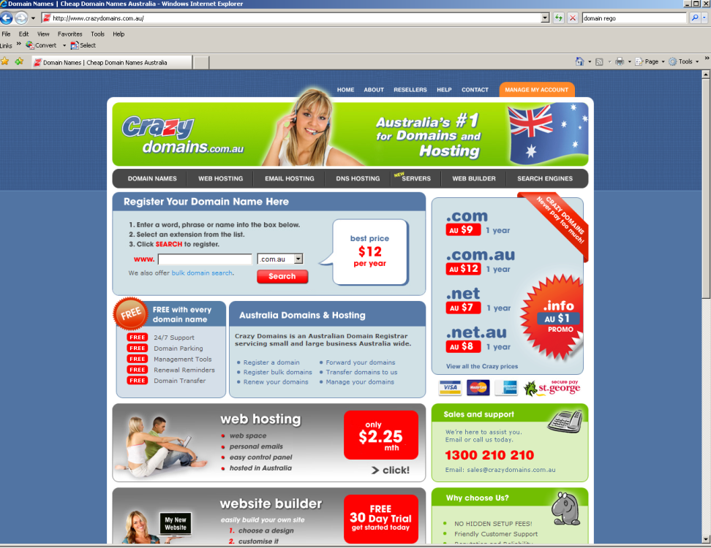
Selecting the Domain Name
Selecting a domain name is an important part of developing an Internet business.
Even if your company already has an established business name, it may not be in your best interest to use that name exclusively on the Internet.
http://www.crazydomains.com.au/

Slide 32
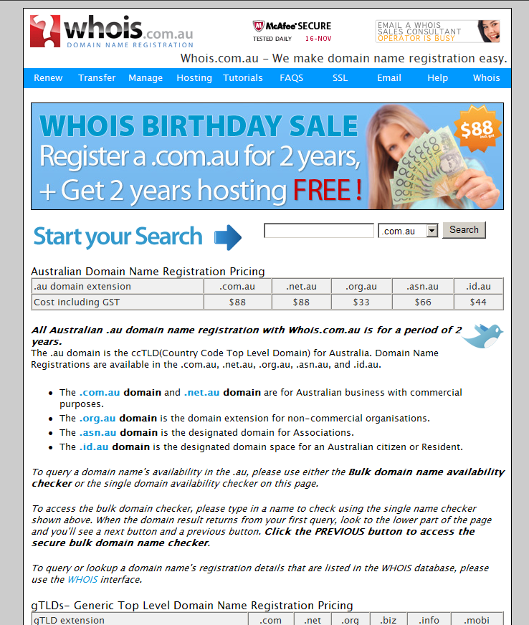
Parking a Site
You may even benefit by using two (or more) domain names, one with your actual business name for customers who would look for you online by typing your company name in their browser (microsoft.com) and one for people who are looking for your product and would look in a search engine (software.com).
http://www.whois.com.au/index.php
Notes:
If you would like to register a domain name for your company, one suggestion www.ondomains.com which has an excellent registration service for only $12.95 per year* *Prices may be subject to change
(Network Solutions is currently still charging $35 per year for the same service)

Slide 33
The secondary Domain Name
You can purchase domain names in the secondary market, if you are not able to find the name you want through the domain registration process.
Do not ignore trademark issues when you are selecting a name. You do not want to find that you have spent significant money developing and promoting your website, and then lose it later to a company with a prior legal claim to the same name.

Slide 34
Selecting the Domain Name
Many people have learned that an easy way to find a product or service they want is to type the name of the product into their browser.
The chances are good that they will find something useful using that method. See what happens when you type in www.toys.com

Slide 35

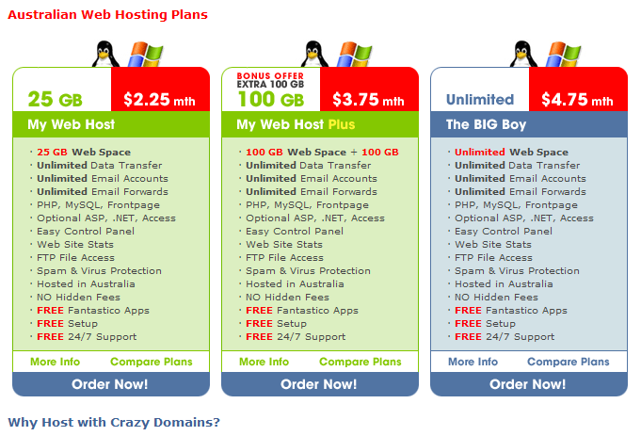
Publishing your Site
A ‘web host’, an ISP must be selected to host your website.
Some web hosts do not include software; others include a large number of software tools to help you run your site more easily.
http://www.clickngo.com.au/index.html
http://www.crazydomains.com.au/web_hosting/index.html

Slide 36
Publishing your Website
Some web hosts supply:
Auto-responders (to send automatic replies to your customers),
Forms for guest books, online orders and questions, search engines to let visitors search your web site,
Chat rooms, bulletin boards,
Online web site management,
Backup file restore programs,
Shopping cart software.

Slide 37
Web Hosting
Range from local ISP with empty space available to Web Developers who host sites on the side, to local hosting companies and national companies that guarantee 99% uptime.
Never use ‘free’ for a business website
Hosting fees vary greatly – cheap is not always good.
Online directory: http://www.thelist.com/countrycode/61/a-c.html

Slide 38
Publishing your Website
When a web host offers - Reliability – They are referring to the percentage of time the hosting server is working and displaying your website.
Access to support personnel - Most hosting companies have support personnel – check to see that they are they easy to contact and how soon can you get help with your problems.
Look for a support page on the host's website and see what is offered. Phone them and Test the service before you buy…. !
Notes:
Unfortunately, these percentages are often reported only by the host company, so their accuracy should not be taken at face value.

Slide 39
Allowable data transfer
When someone visits your web page, they cause data (web page code and images) to be transferred from the server hosting your web page down to their individual computer.
If you have many visitors who look at everything on your web site, this transfer puts a strain on the resources of your host server. For this reason, limits are generally placed on the amount of "traffic" your site may receive before you are charged extra.

Slide 40
Server hard drive space
An average web page is 10K to 60k. Pictures and other graphics usually range on size from about 1K to 25K.
This means that if you have a 10 to 15 page website with 2-5 graphics on each page, you will need 120K to about 3MB (3,000K or 3,000,000 bytes) to save your website on a server.
In the above example, assuming the maximum web site size (about 3MB), and assuming 1,000 visitors per day viewed everything on your website once, you would need to transfer 30MB per day or about 1GB per month.
Notes:
30 x 30 =1000- 1GB
Therefore, in most cases, offers of more than 10-25MB of space are made mostly to impress prospective customers who really do not understand how much they need. It just sounds good.

Slide 41
Publishing your Website
Even if you have a much larger website with many more graphics, your website should be able to fit comfortably onto about 10MB of hard disk space.
When web hosts offer you 400MB of hard disk space, they do so knowing that the vast majority of users will not come close to using all of that space.

Slide 42


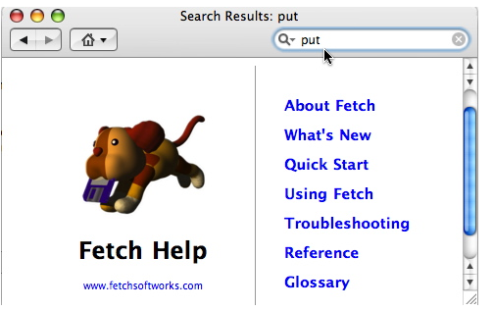
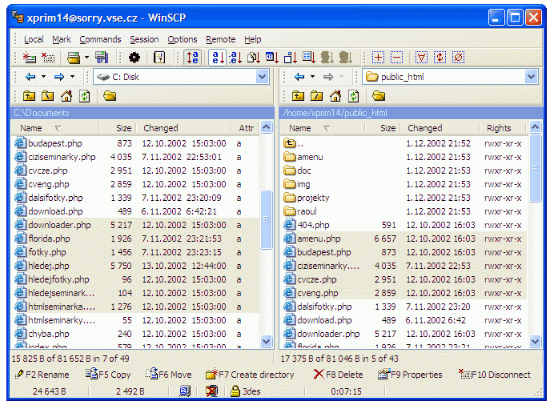
Publishing your Website
There are many ways for you to upload your web pages to your server.
FTP or other access - the quickest and easiest is by using an FTP (File Transfer Protocol) program.
Dreamweaver offers an built-in FTP module or you may have an FTP program on your computer already. If not - FTP programs are inexpensive to purchase or even free.

Slide 43
Publishing your Site
FTP is often now used as a description and a noun in common language.
“I used an FTP program to upload my files”
“I am going to FTP all my files now”
http://winscp.net/eng/index.php - free for Windows
http://cyberduck.ch/ - free for Mac users
http://www.cuteftp.com - for Windows
http://fetchsoftworks.com/ - for Mac

Slide 44
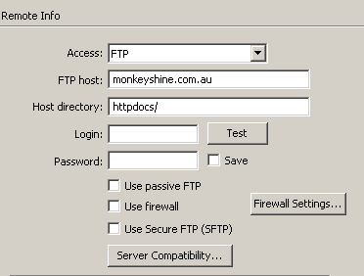
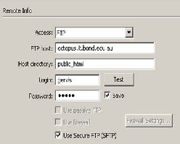
Publishing your Site
Setting | Description
FTP Host | An address similar to the URL of your website.
Host Directory | The directory or server where you are supposed to place your files.
Login | A username or ID for Remote access
Password | A password for Remote access
Use Passive FTP
Use Firewall
Use Secure FTP

Slide 45
Publishing your Website
POP accounts – (Post Office Protocol) These allow you password-protected access to mail sent though your website email address.
You may want to set up separate POP accounts for each major department in your company. You should ask how many POP accounts your host allows you to have without paying extra.
POP is the other part of SMTP (Simple Mail Transfer protocol)

Slide 46
Secure server
Many web hosts offer secure server space for an additional monthly fee.
Secure (or encrypted) server space is needed if you plan to accept credit card information or other sensitive data on your website.
If this data is not encrypted (coded so it cannot be read except by the intended recipient), then it can be viewed by others and potentially stolen.

Slide 47
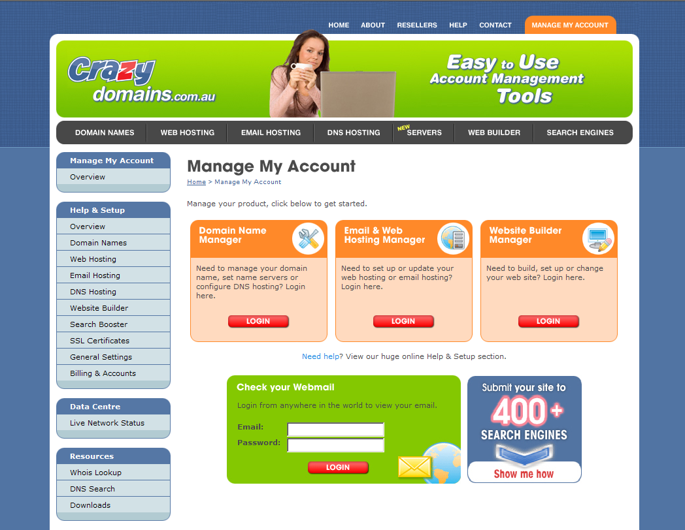
Domains and hosting
http://www.cheapdomain.com.au/cheap/hosting.jsp
http://www.ilisys.com.au
http://www.clickngo.com.au/
http://www.crazydomains.com.au/login/index.html

Slide 48

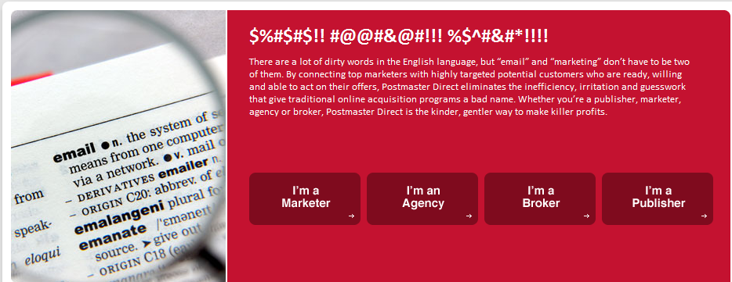
Online Payment
www.paypal.com.au
http://www.postmasterdirect.com/ Email lists are lists of people who have said they are willing to receive advertising messages. These can be purchased according to their location.

